Slide 1
Caregiver Interface - Harsh (Sai)
Where this is
The task. We take a recording from the glasses and produce two things. Where the object travelled through the room and the 3D points that make up the object. Nothing is marked on the object and nothing is labelled by hand.
The data. Twelve recordings made on 8 October. Pouring from a jug, scooping with a spoon, picking up a tin and gripping a spoon three ways. Each task was recorded three times so a measurement can be checked against itself.
This week. The object's full pose. Not only where it is but which way it is turned, written as a 4 by 4 matrix for every frame of all thirteen tracked windows. That is 3,035 frames. Every matrix has been checked to be a genuine rigid body transform.
Notes:
This is the recap slide. Two deliverables, twelve recordings, and this week the pose.

Slide 2
Caregiver Interface - Harsh (Sai)
What an SE(3) pose is
A position is not enough. Three numbers say where the jug is. They do not say whether it is upright or tipped out. For pouring the tilt is the whole task, so a recording of position alone is not a demonstration of pouring.
A pose is both together. R is 3 by 3 and holds which way the object is turned. t is 3 by 1 and holds where it is.
T = [ R t ]
[ 0 1 ]
4 by 4, with R inside it as 3 by 3
Why one 4 by 4 matrix. Write a point as four numbers ending in 1 and the turn and the shift become a single multiplication, p' = T p. A sequence of movements is then a product of matrices. Undoing a movement is an inverse. That is what lets a measurement move between frames of reference without anybody tracking the bookkeeping by hand.
Measured from the first frame. Every pose we write is T(0) inverse times T(k), so the first row of every file is the identity. The numbers then read as the movement since the demonstration began.
Notes:
Make the point that position alone loses the pour. Then the formula, then why 4 by 4, then relative to the first frame which is what was asked for.

Slide 3
Caregiver Interface - Harsh (Sai)
Where the rotation comes from
The glasses give two transforms directly. Their own tracking says where the glasses are in the room. The hand tracker says where the wrist is relative to the glasses. Multiplying the two puts the hand in the room, which is what was asked for.
T room-wrist = T room-device x T device-wrist
The object is not the wrist. While it is gripped it sits at some fixed offset X from the wrist. Nobody can measure X, so the object's movement since the first frame is X inverse times the wrist's movement times X.
object movement = X^-1 ( T wrist(0)^-1 T wrist(k) ) X
The angle survives that. Conjugating a rotation leaves its trace alone and the angle comes straight from the trace. So the object turns by exactly the same angle as the wrist whatever X happens to be. That is what makes the wrist's rotation worth reporting as the object's, and it is checked on real data on the next slide.
The position never touches the hand. It comes from the object's own 3D points, which the pipeline already has in room coordinates.
Notes:
The conjugation argument is the key one. X is unknown and it does not matter, because conjugation preserves the trace and the angle comes from the trace.

Slide 4
Caregiver Interface - Harsh (Sai)
Proof that these really are rigid body transforms
Run on the committed pose files. Every property is tested on every frame.
$ python3 tools/object_pose.py --check
property | worst error | why it matters
R R^T = I | 2.1e-06 | a rotation preserves every length and angle
det R = +1 | 2.0e-06 | a reflection is not a movement
T(0) = I | 0.0e+00 | the pose is relative to the first frame
theta = arccos((tr R - 1)/2) | 5.1e-03 | the angle column matches the matrix
|axis| = 1 | 7.9e-06 | the axis is a direction
T^-1 T = I, T^-1 = [R^T, -R^T t] | 1.9e-06 | undoing a movement
T(a->b) T(b->c) = T(a->c) | 1.8e-06 | movements chain by multiplying
angle(X^-1 R X) = angle(R) | 1.2e-06 | the object turns as far as the wrist
3,035 frames across 13 recordings. Every property holds to the precision the file stores, which is six decimal places on the matrix and two on the angle column. Nothing on this slide is asserted.
Notes:
This is the slide that shows the concept is understood. Each line is a property a rigid body transform must have and each number is measured on our own output.

Slide 5
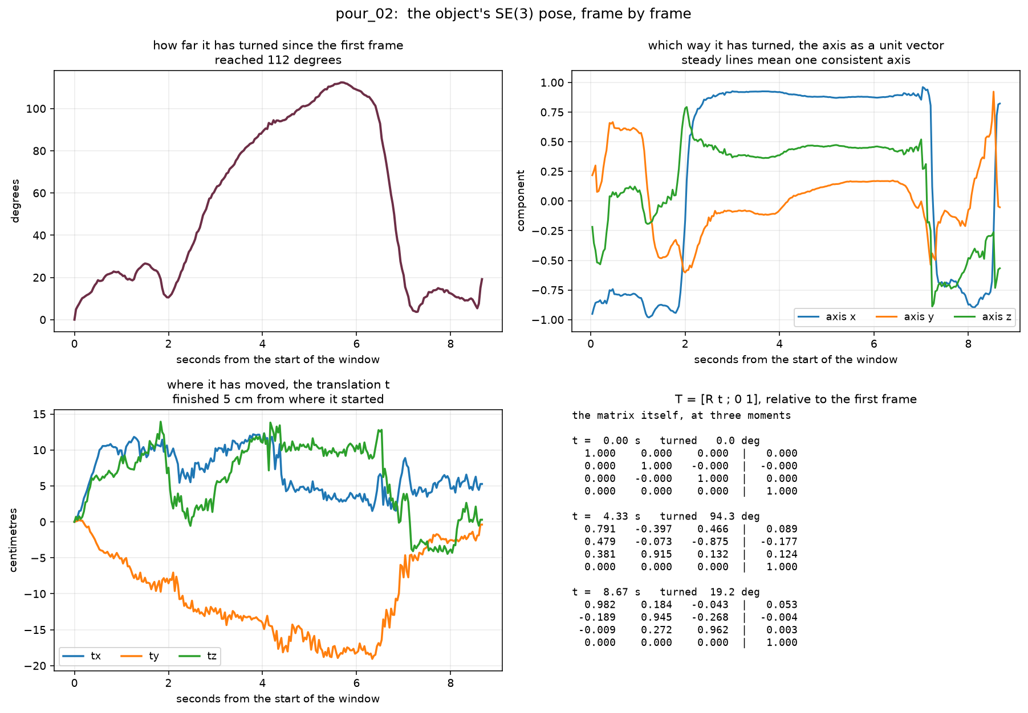
Caregiver Interface - Harsh (Sai)
A moving object: a jug tipped over a bowl
What it shows. The jug turned 112 degrees and finished 5 cm from where it started. The turn is the task. The position barely moves, so a recording of position alone would have missed this demonstration entirely.
Reading it. Top left is how far it has turned since the first frame. Top right is the axis it turned about, which settles onto one steady direction between 2 and 7 seconds while the jug is tipped and comes back. Bottom left is the translation. Bottom right is the matrix itself at three moments.
outputs/object_pour_02_pose.png, drawn by tools/render_pose.py
Notes:
Point at the angle curve first. It rises to 112 and comes back, which is the pour and the return. Then say the translation panel is almost flat.

Slide 6
Caregiver Interface - Harsh (Sai)
A static object: the red bowl nobody touches
Both cases were asked for. scoop_01 holds a red bowl that is never picked up. A thing that does not move has one pose for the whole window, so there is nothing to track frame by frame.
The code decides by measuring. The bowl's own 3D points move through a box 6.1 cm across over the window. That is below the 10 cm line separating a resting object from a carried one, so it is given one fixed pose. Carried objects in these recordings measure 15 cm and upwards, so the line has room on both sides.
That makes the bowl the error bar. A thing that never moves should measure zero movement. Seen through the glasses it appears to travel through a box 13.9 cm across, purely because the wearer's head moves. Converted into room coordinates that falls to 6.1 cm and the typical frame is out by 0.69 cm.
So 0.69 cm is the number. That is the error on every object position this project reports. It was measured on a real object and nothing about it was assumed.
Notes:
The zeros in the static pose file are a consequence of the resting classification, which itself came from the measured 6.1 cm span. The real measurement here is the 0.69 cm.

Slide 7
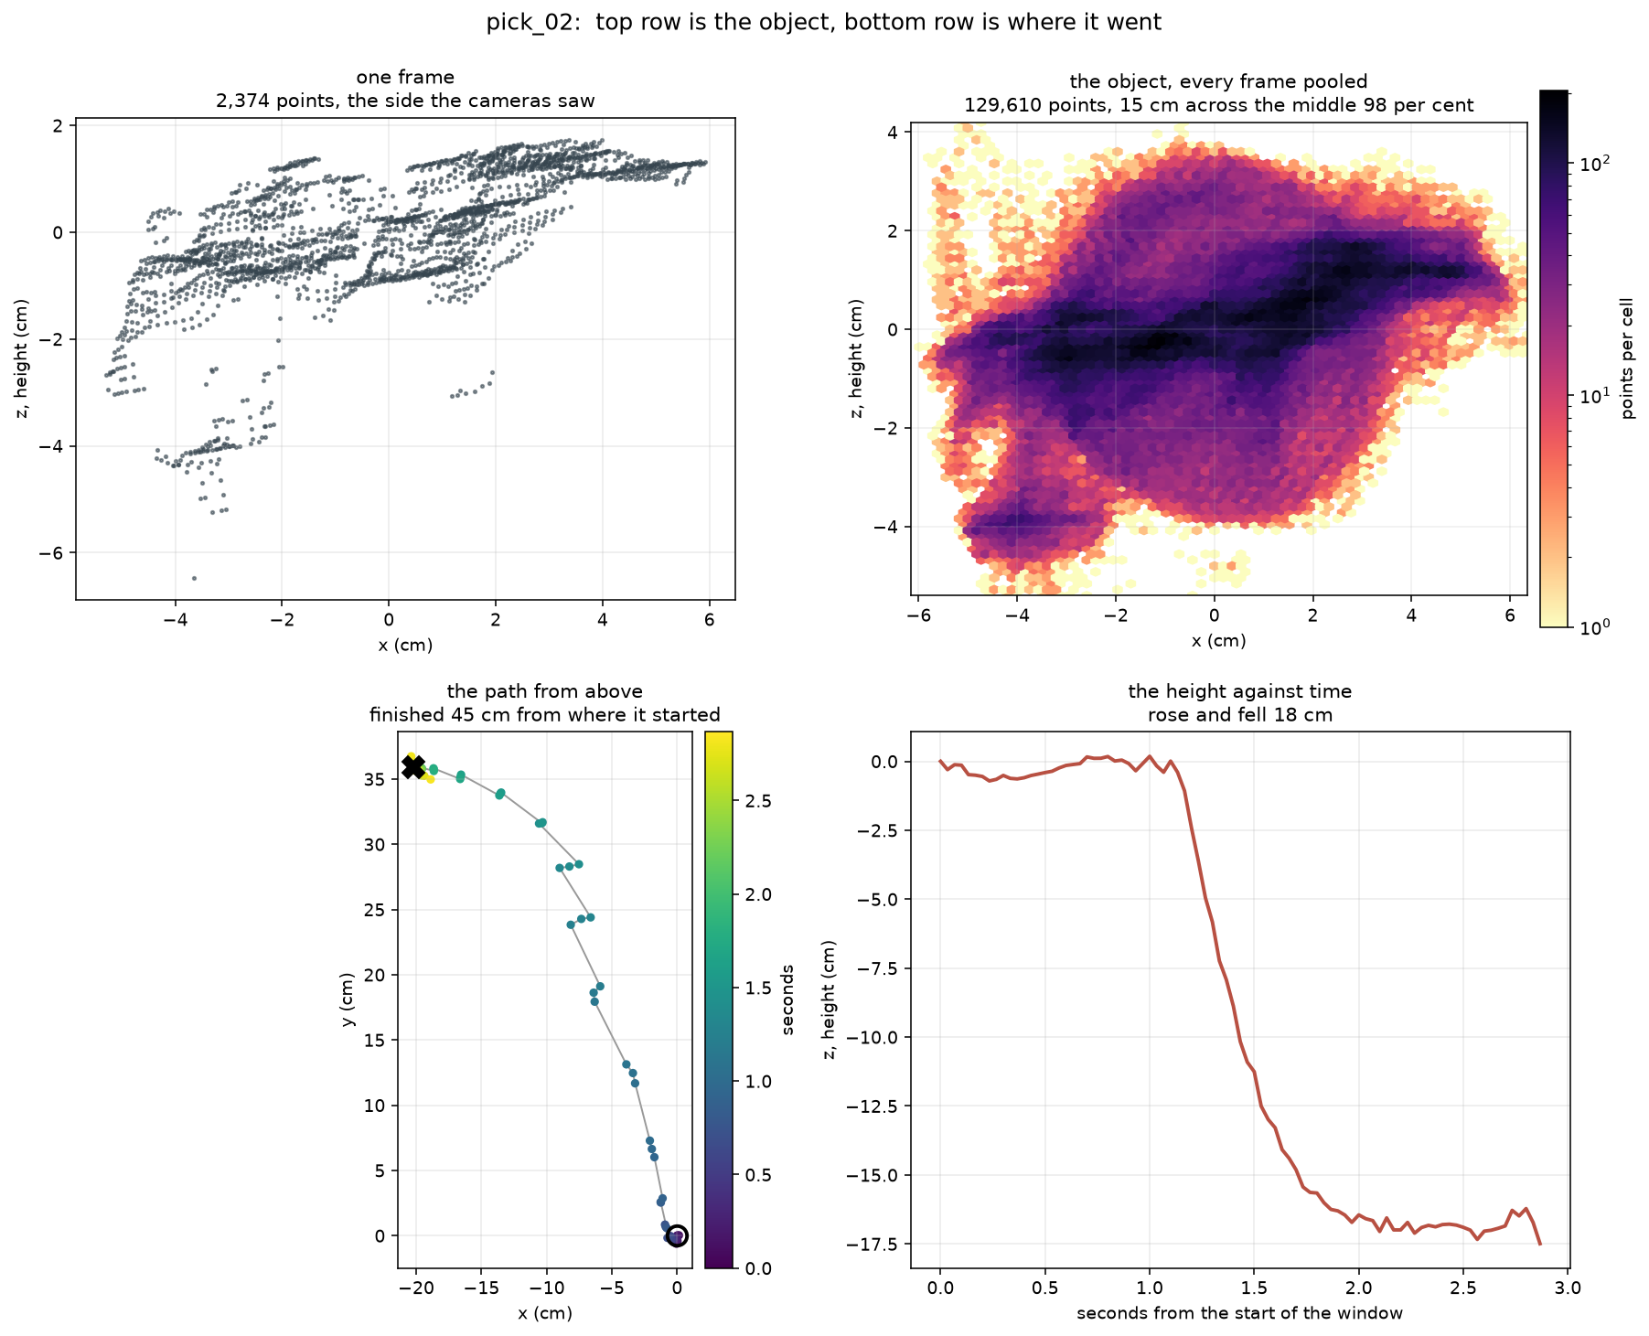
Caregiver Interface - Harsh (Sai)
The two deliverables, on pick_02
One frame. The side both cameras could see at one instant. There is no depth sensor on these glasses, so depth comes from comparing the two front cameras and neither can see round the back.
The object. Every frame carried back into the object's own frame, where the object stands still and the path falls away. Drawn as a density because a hundred thousand dots paint a solid block. The dark core is the tin. The pale halo is stereo noise, and that halo is where the haze comes from.
The path. The bottom row is the trajectory with no surface points at all. The tin was carried 45 cm and set down 18 cm lower.
outputs/object_pick_02_cloud.png, drawn by tools/render_object_cloud.py
Notes:
Say plainly that the top row is the object and the bottom row is where it went. The earlier version of this figure drew both at once and was unreadable.

Slide 8
Caregiver Interface - Harsh (Sai)
What is left
The jug comes out too wide. A spoon pools to 14 to 22 cm and a tin to 14 to 16, which are the right sizes. A jug pools to 47 to 52 cm, which is two to three times a real jug. The jug turns the most while it is carried, so it is the most exposed to the rotation being rough. Fitting each frame to the model brings all three to 45 cm, which is better and still wrong.
Finding contact over-calls. Measuring the distance from the hand to the object agrees with Meta's own labels 67.2 per cent of the time on their kitchen recording, against 46.9 for the method that read the shape of the hand. It still marks contact on 73.7 per cent of frames where they mark 46.7, because it holds on while the hand lingers after setting the object down.
Choosing which object. Starting at the hand and stepping towards where the wearer is looking lands on the right object 46 per cent of the time against a ceiling of 54. Where the target is a spoon inside a bowl it lands on the bowl. Finding where the work is happening is close to solved. Telling one object from another there is not.
The gaze interface. The signal is measured. Nothing yet turns it into something a person uses.
Notes:
Four items, each with the number that says how far off it is.

